Slide 1
Intel’s makers community The ESP32-S3 mini platform and parts purchasing
Gil Tal.
Oct 2024

Slide 3
Course agenda:
Block diagram
Parts list
Schematic
Reference Links for parts

Slide 4
Board producing process
Block diagram
Components
Pick up
Schematic
ERC +
Netlist
Board
creation
Placement
Set rules
For routing
Assembly
Purchase
components
Send board
To production
Generate
Production
Files
DRC
Routing
Power On
☺

Slide 5
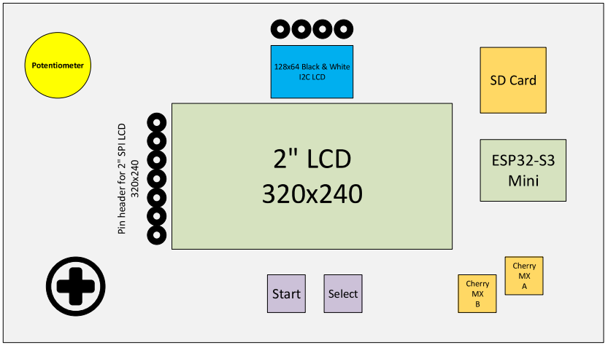

Slide 6
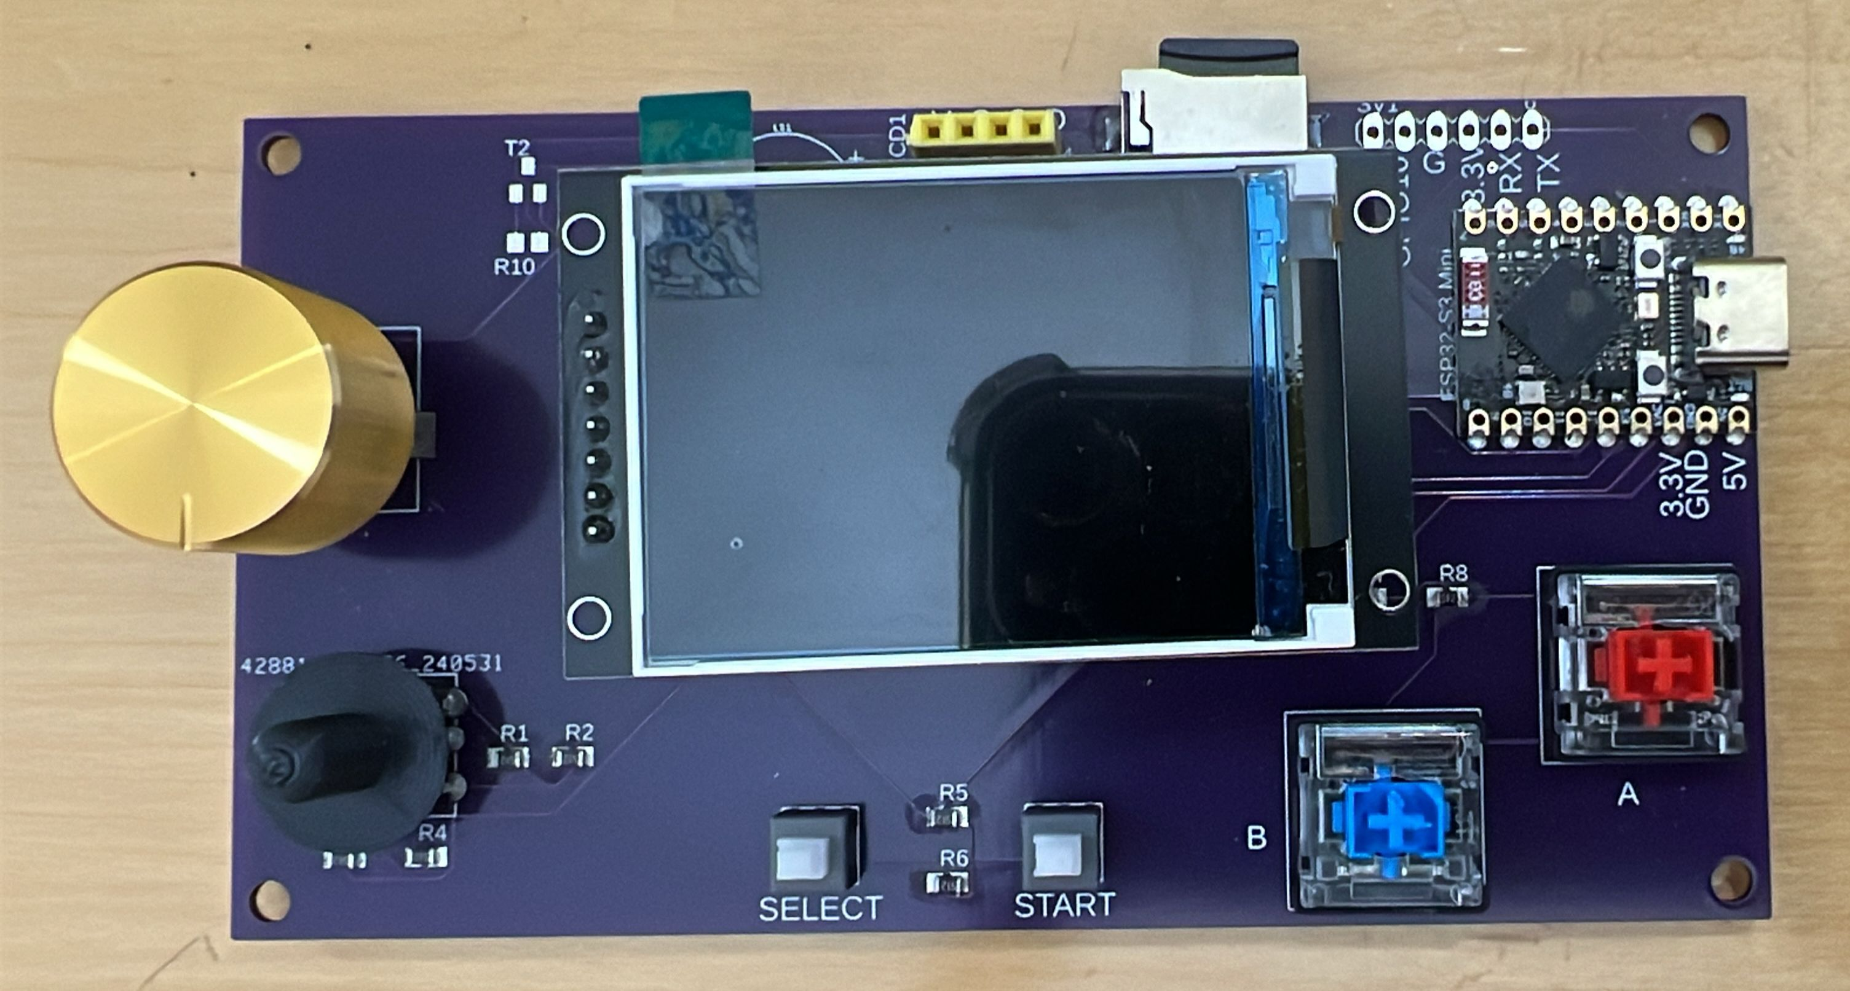

Slide 7
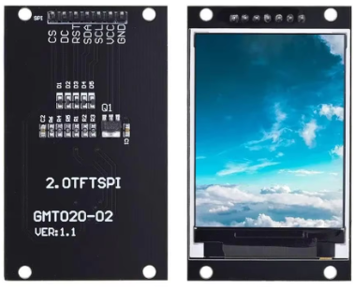
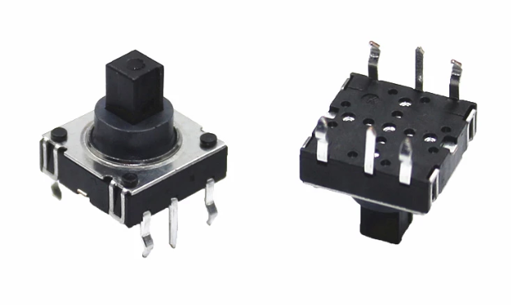
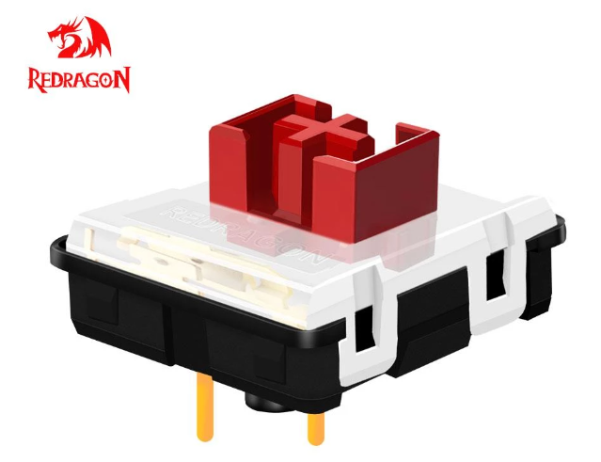
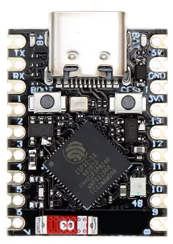
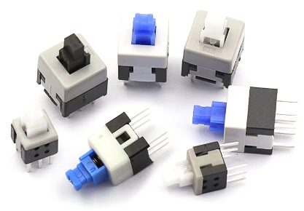
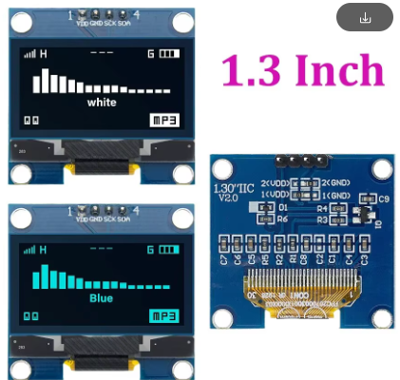
What we need for the Platform?
ESP32-S3 mini
LCD screen: 2” 64K colors, SPI interface
Tactile joystick
2 low profile cherry-MX buttons
2 switches
Buzzer
SD card slot
7 and 4 Pin headers

Slide 8
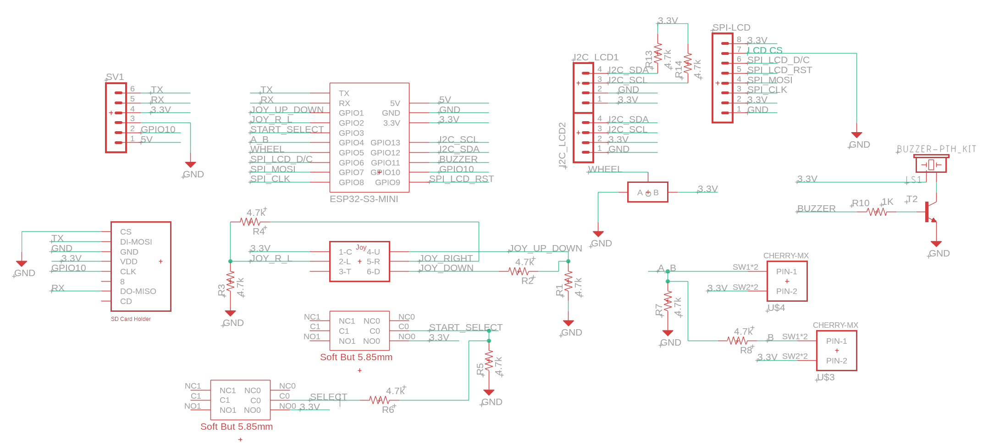

Slide 9
Parts links:
https://www.aliexpress.com/item/1005004108793838.html?spm=a2g0o.order_list.order_list_main.232.21ef18023mUIKX
https://www.aliexpress.com/item/32985880305.html?spm=a2g0o.order_list.order_list_main.227.21ef18023mUIKX
https://www.aliexpress.com/item/1005005818694764.html?spm=a2g0o.order_list.order_list_main.205.21ef18023mUIKX
https://www.aliexpress.com/item/1005007523612119.html?spm=a2g0o.order_list.order_list_main.262.21ef18023mUIKX
https://www.aliexpress.com/item/1005006960134338.html?spm=a2g0o.order_list.order_list_main.257.21ef18023mUIKX
https://www.aliexpress.com/item/1005006862732813.html?spm=a2g0o.order_list.order_list_main.289.21ef18023mUIKX
https://www.aliexpress.com/item/4000345581311.html?spm=a2g0o.productlist.main.3.6691231217t0rO&algo_pvid=165c6838-093a-464a-9470-dfc9e0278303&algo_exp_id=165c6838-093a-464a-9470-dfc9e0278303-1&pdp_npi=4%40dis%21ILS%213.78%213.78%21%21%210.97%210.97%21%40214100f417282002225144118eae29%2110000001423321557%21sea%21IL%21927794949%21X&curPageLogUid=t48T8PzzYZmm&utparam-url=scene%3Asearch%7Cquery_from%3A
https://www.aliexpress.com/item/1005006691026564.html?spm=a2g0o.productlist.main.43.55a560260V5Mfh&algo_pvid=c907a18b-d068-469c-8d3c-824f516ea48b&algo_exp_id=c907a18b-d068-469c-8d3c-824f516ea48b-21&pdp_npi=4%40dis%21ILS%218.72%215.06%21%21%2115.85%219.19%21%402140e84617282827883172856eccd9%2112000038111586489%21sea%21IL%21927794949%21X&curPageLogUid=1ORCkegBZGMh&utparam-url=scene%3Asearch%7Cquery_from%3A

Slide 10
